Slide 1
UK Cansat Competition 2016
Teachers’ workshop

Slide 2
Background to ESERO and CanSat
Workshop schedule, Housekeeping,
Impact Toolkit, Community Group
3. Competition guidelines
Reporting
“Launch” date
Reporting template
Who pays for what?
CREST accreditation
Questions?

Slide 3
ESERO-UK
www.stem.org.uk/esero
Using a space context to support STEM teaching and learning
7000 teachers trained
200000 resource downloads

Slide 4
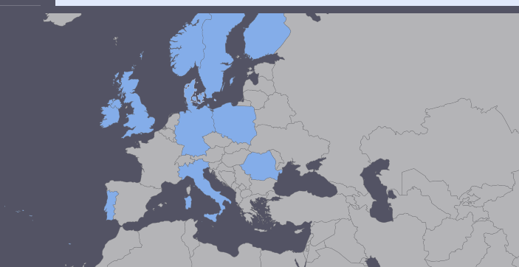
CanSat
European CanSat competition http://www.esa.int/Education/CanSat
National competitions

Slide 5
2. Workshop schedule and housekeeping
In the event of a fire
Water, coffee, getting in and out
Franklin House
Impact Toolkit
Community Group

Slide 6
3. Competition guidelines
Phase 1: Call for proposals and team selection
Activity | Deadline
Call for proposals opens | May 2016
Deadline for proposals | 8th July 2016
Announcement of selected teams | 22nd July 2016
Phase 2: Teachers’ introductory workshop
Activity | Deadline
Teachers’ introductory workshop | 23rd September 2016
Phase 3: CanSat construction and test activities
Activity | Deadline
Progress report 1 | 31st October 2016
Progress report 2 | 12th December 2016
Progress report 3 (as-built documentation) | 28th February 2017

Slide 7
3. Competition guidelines
Phase 4: Competition launch campaign and post-flight activities
Activity | Deadline
Competition launch campaign and awards | 9-11 March 2015

Slide 8
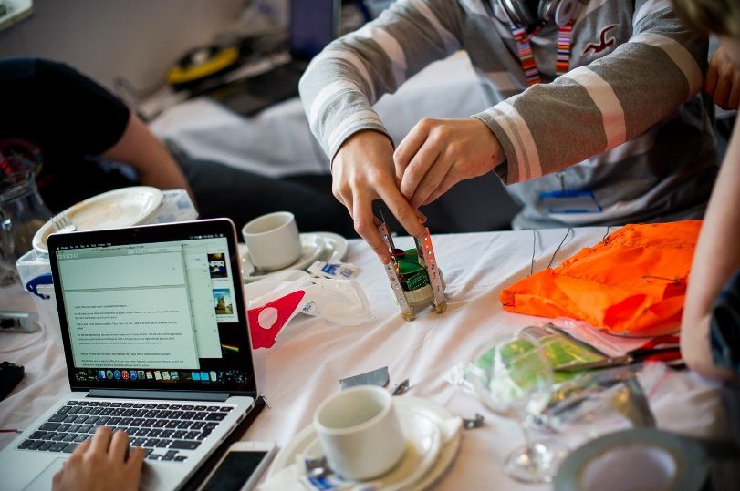
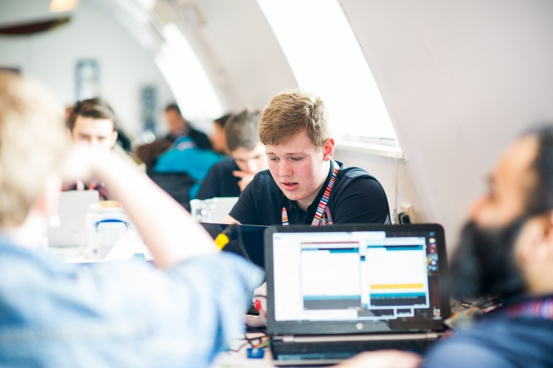
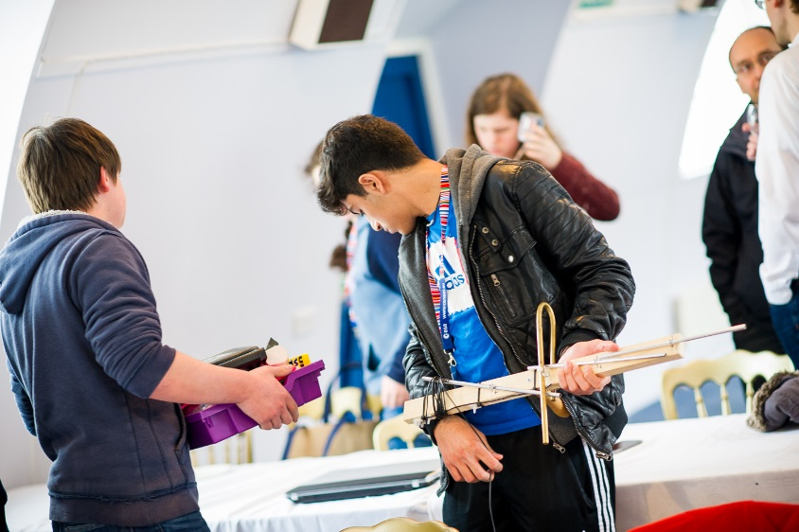
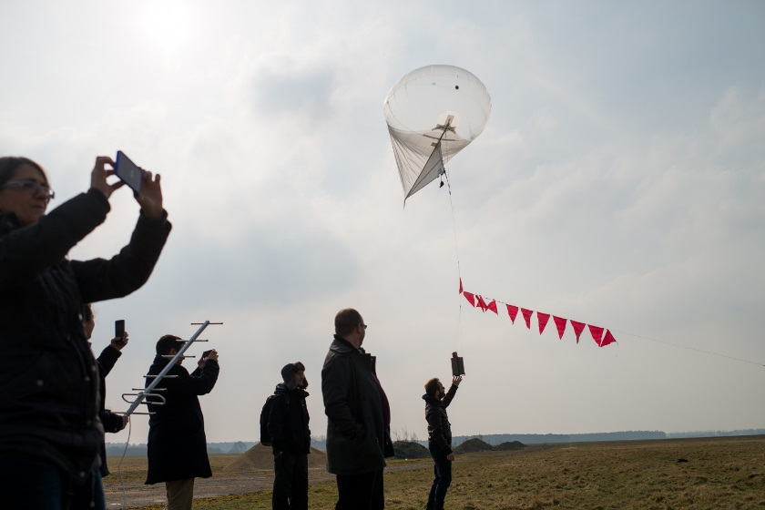

Slide 9
4. Reporting template / Design Doc

Slide 10

Who pays for what?
See section 5 of Guidelines document…plus
the total budget of the CanSat should not exceed £400.
Cansat kits cost £100, so this leaves
£300

Slide 11
6. CREST accreditation

Slide 12
7. Questions?

